Slide 1
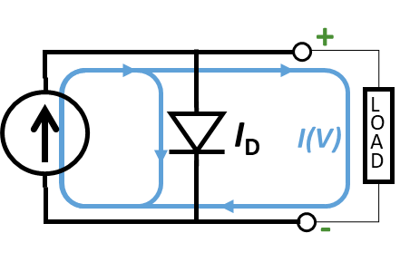
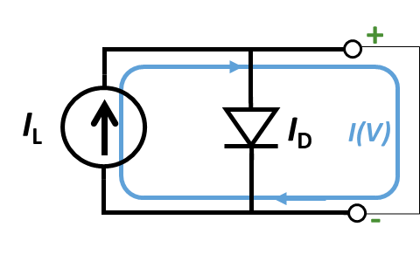
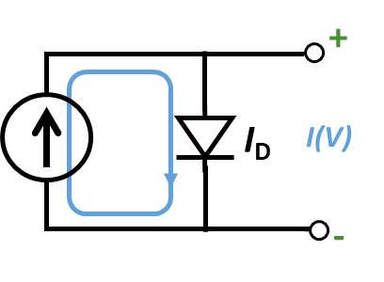
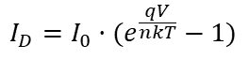
+
I_{L}
I_{D}
V
-
$${I_{D}=I}_{0}·(e^{\frac{qV}{nkT}}−1)$$
+
+
I_{L}
I_{D}
I_{L}
I_{D}
LOAD
I(V)
I(V)
-
-
+
I_{L}
I_{D}
I(V)
-

